Slide 1
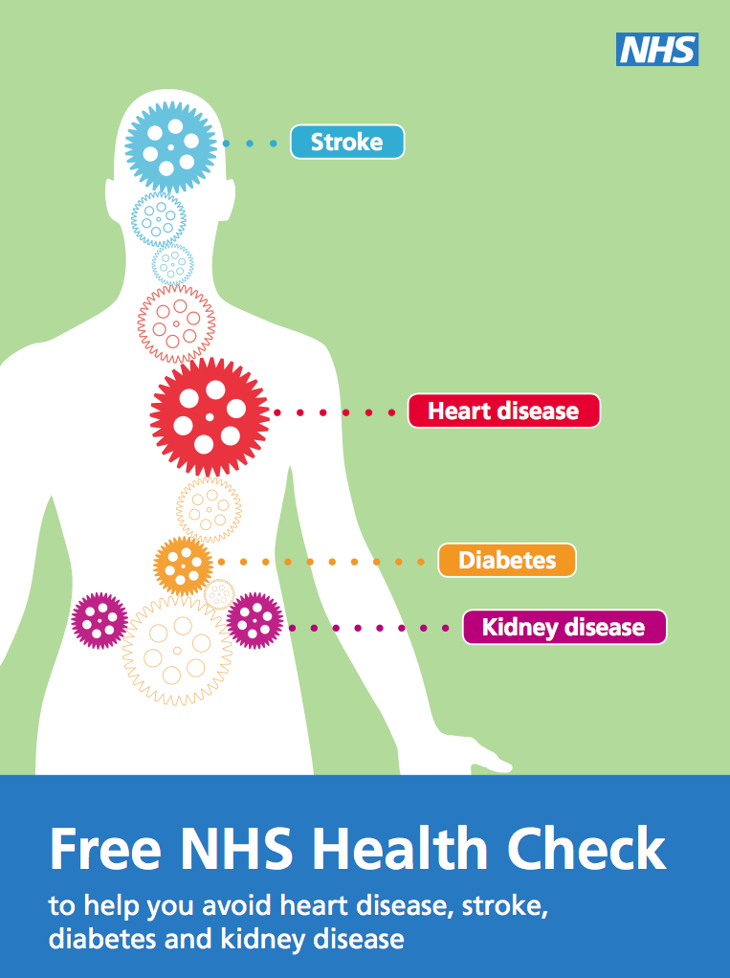
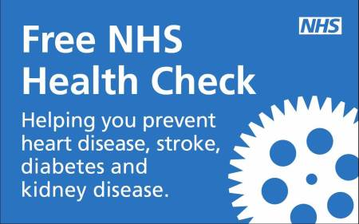
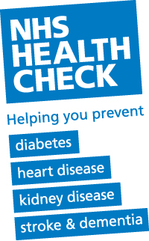
NHS Health Checks
Afshan Aghlili

Slide 2


Aims of Session
To review the evidence base underpinning the NHS Health Check Program
Develop your understanding of a national public health campaign
Understand the design and execution of the NHS health checks (Islington Model)

Slide 3

Leaning Outcomes
By the end of this session, students should be able to:
associate the epidemiology of risk factors with CVD
- understand the basis of and need for a public health intervention
- appreciate the value of critically evaluating the usefulness of public health programs

Slide 4
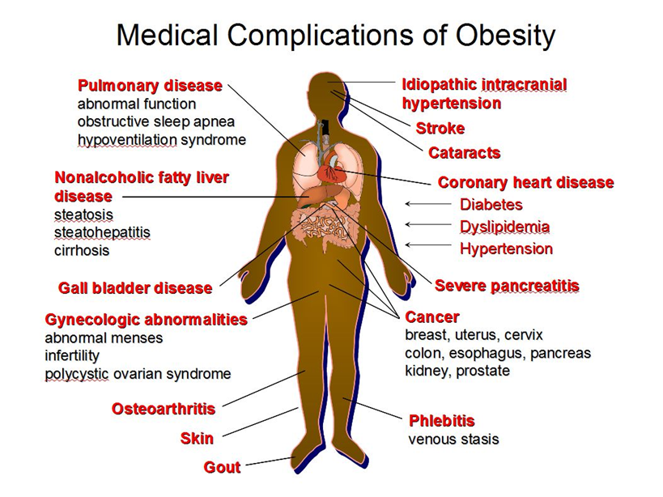
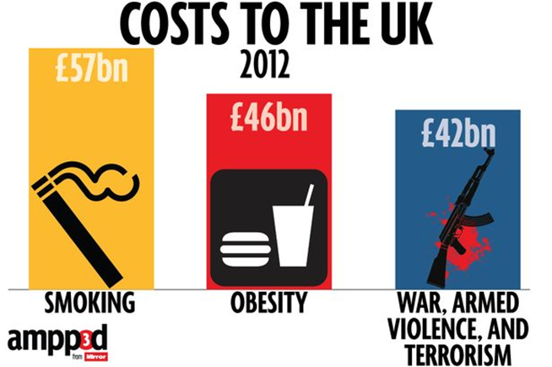
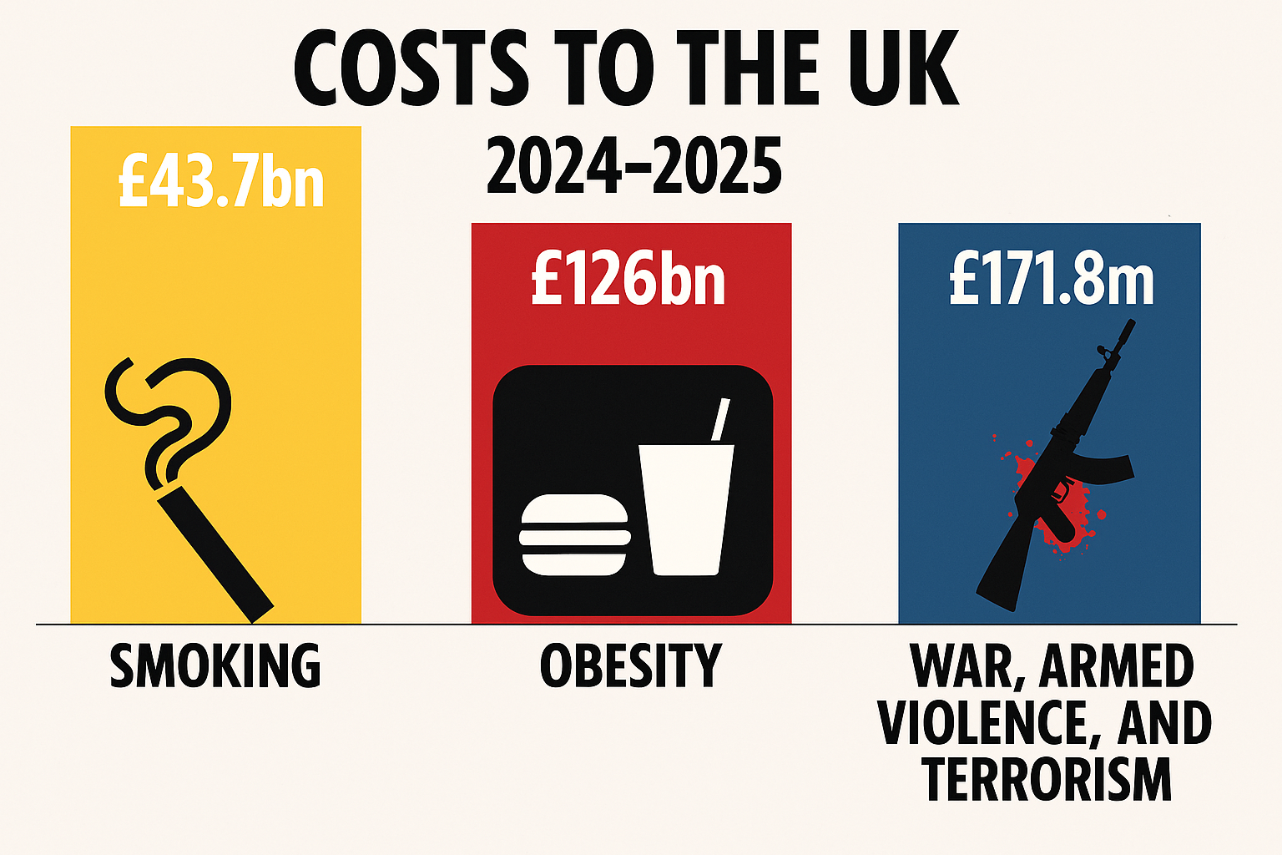

Slide 5
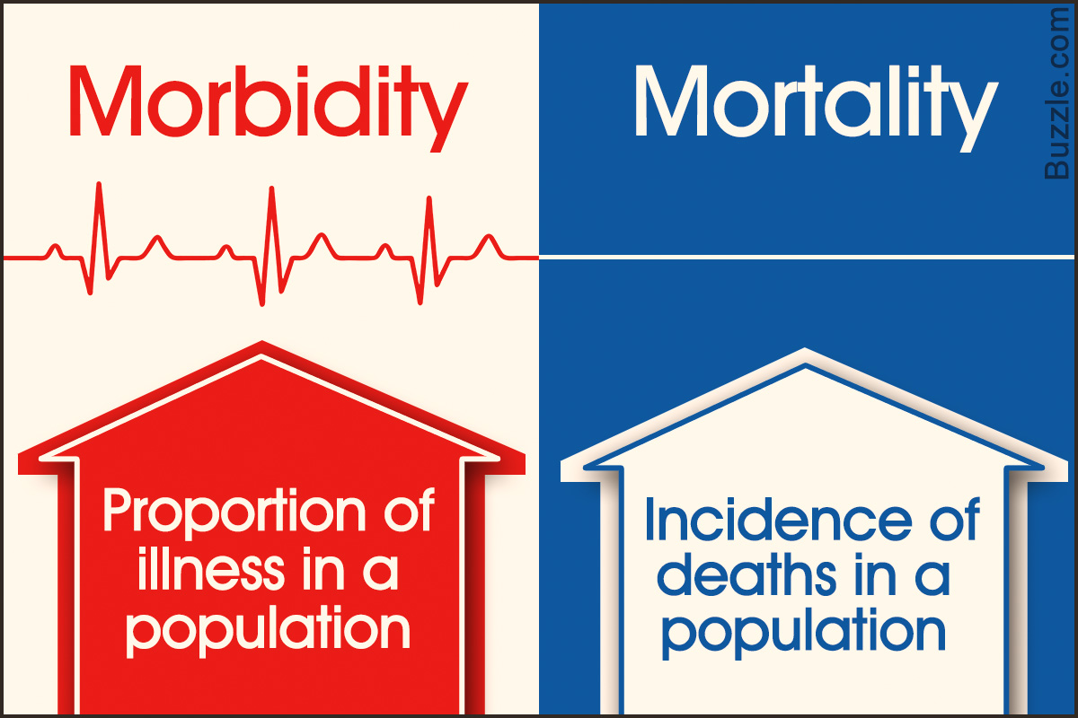

Slide 6
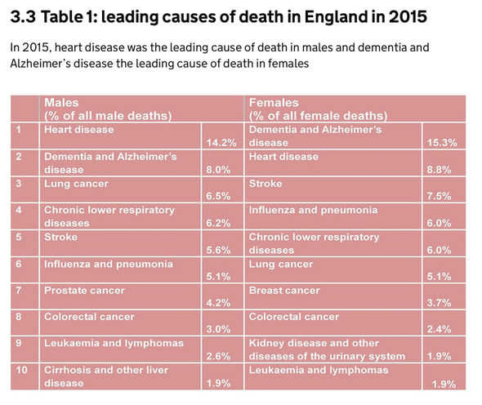
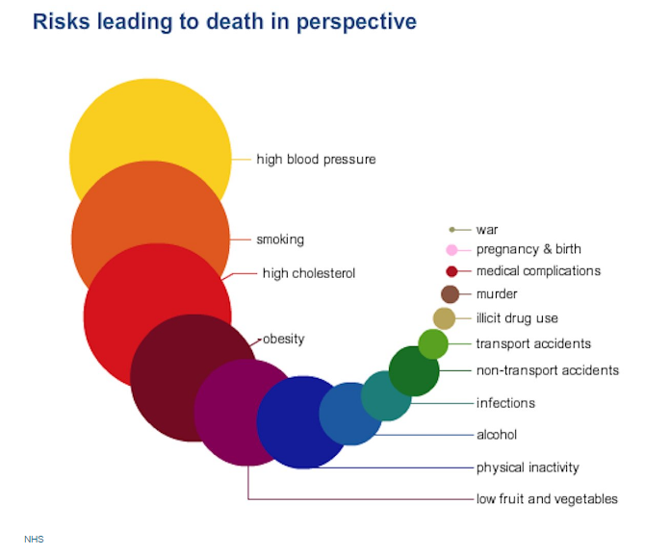

Slide 7
Leading Causes of Death in England: 2015 vs 2024
Rank | 2015 (England) | 2024 (England)
1 | Heart disease (14.2%) | Dementia & Alzheimer’s (12.1%)
2 | Dementia & Alzheimer’s (8.0%) | Ischaemic heart disease
3 | Lung cancer (6.5%) | Cerebrovascular disease incl. stroke
4 | Chronic lower resp. (6.2%) | Lung cancer
5 | Stroke (5.6%) | Chronic lower resp. disease
6 | Influenza & pneumonia (5.1%) | Other cancers
7 | Prostate cancer (4.2%) | Influenza & pneumonia
8 | Colorectal cancer (3.0%) | Liver disease
9 | Leukaemia & lymphomas (2.6%) | Chronic kidney diseases
10 | Liver disease (1.9%) | Accidents & external causes

Slide 8
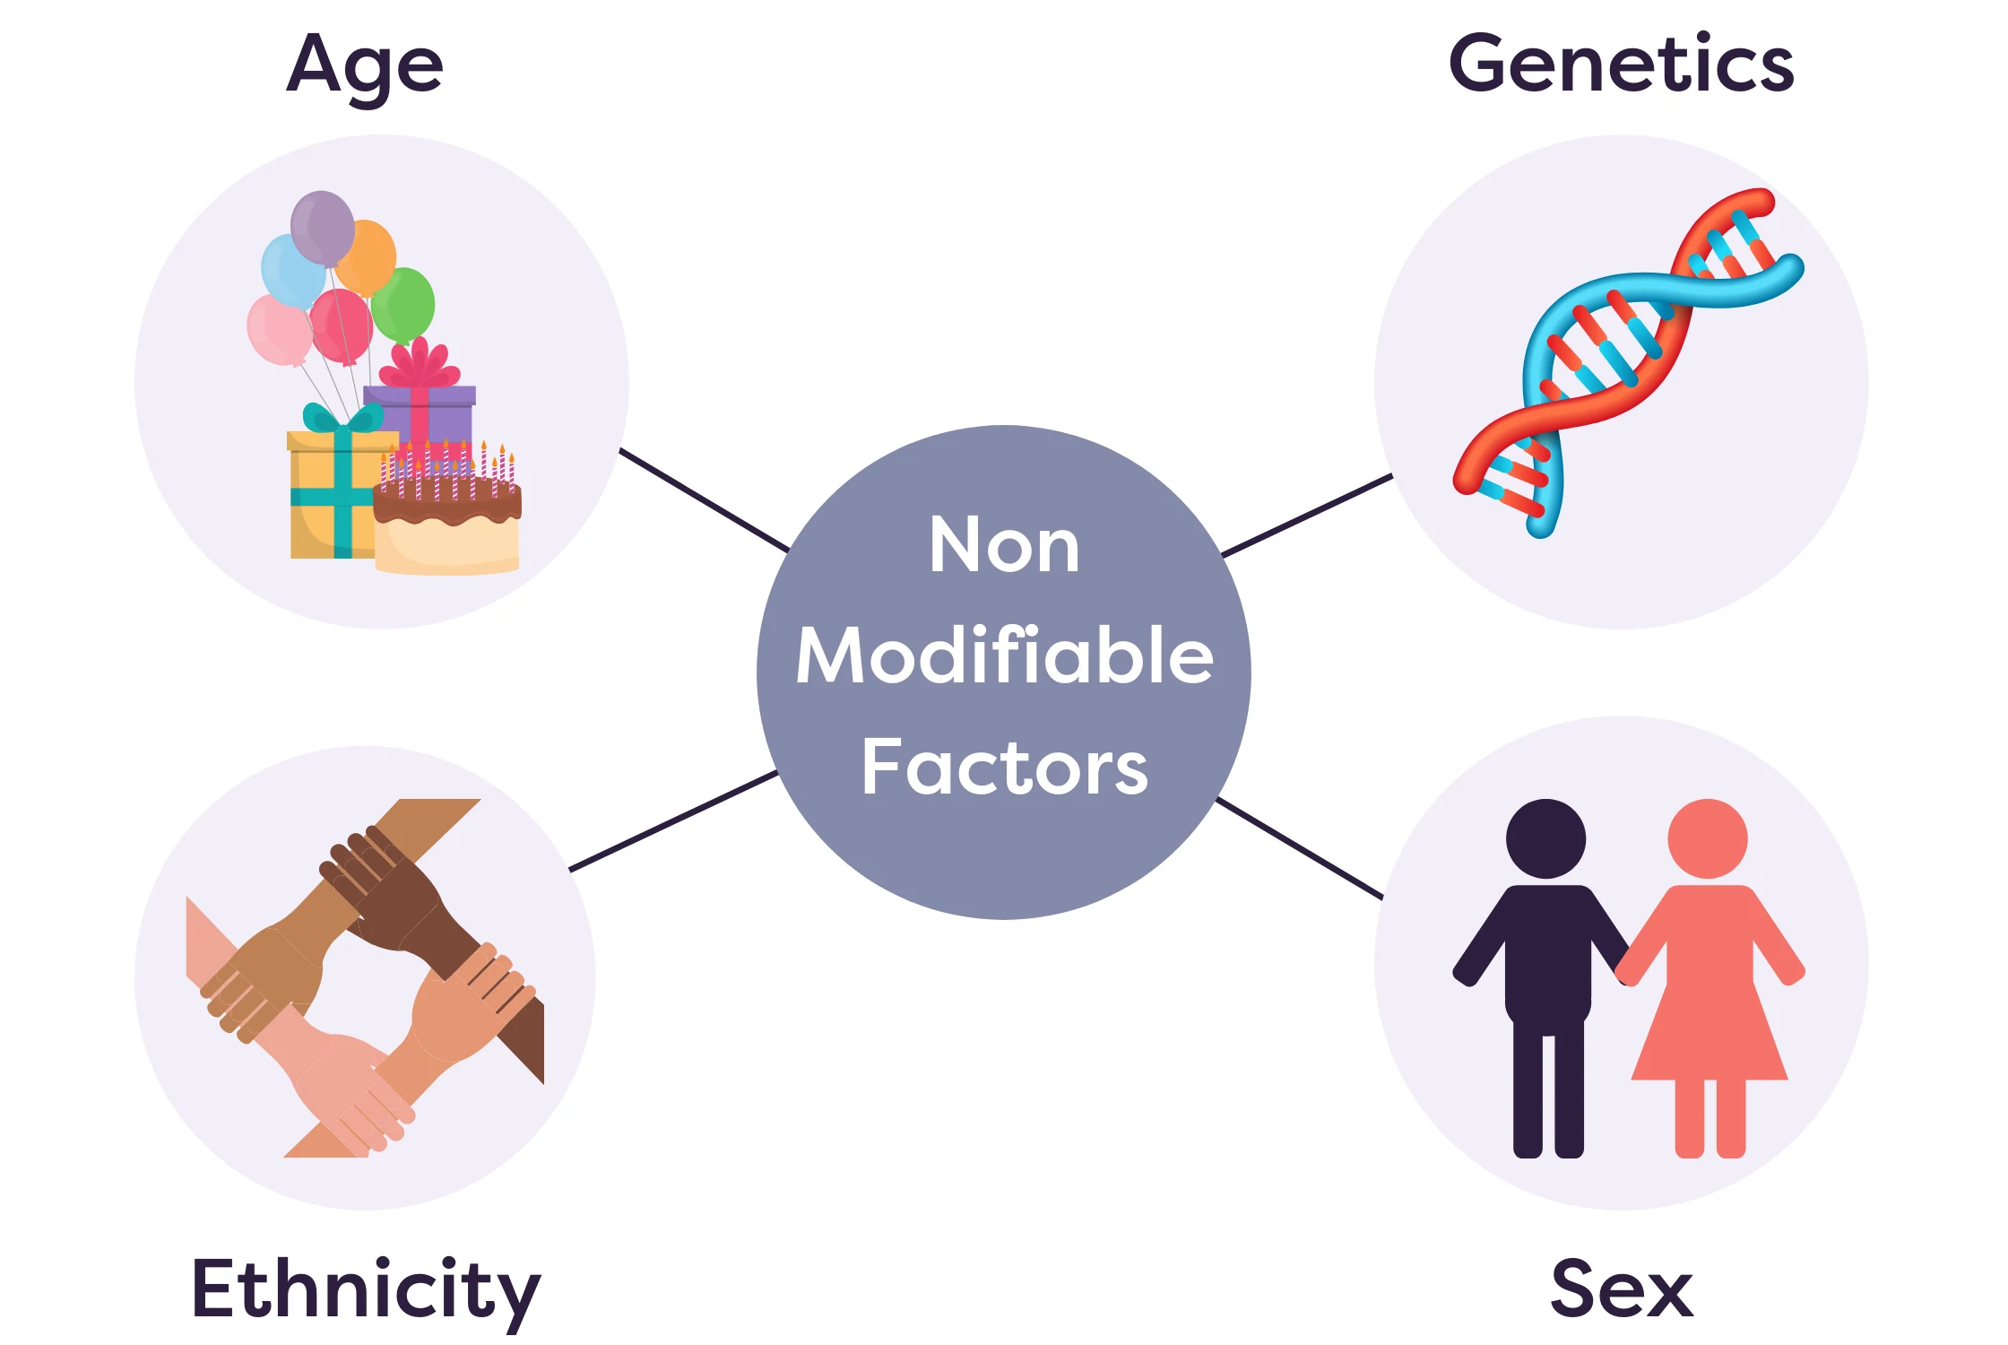

Slide 9
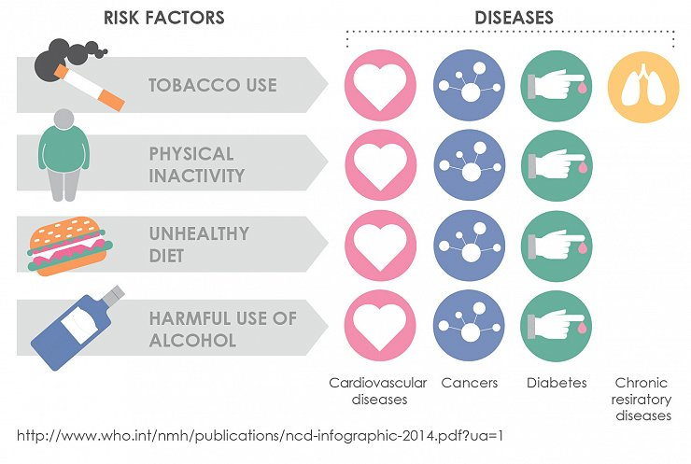
Modifiable risk factors
  Diet
  Physical activity
  Body weight
  Smoking

Slide 10
Modifiable risk factors
  In more than 90% of cases, the risk of developing CHD is related to nine potentially modifiable risk factors (Yusuf et al. 2004):
  smoking/tobacco use
  poor diet
  high blood cholesterol
  high blood pressure
  physical inactivity
  overweight/obesity
  Diabetes
  Psychosocial stress (linked to people's ability to influence the potentially stressful environments in which they live)
  Excess alcohol consumption
  Other factors, such as maternal nutrition and air pollution may also be linked to the disease (Allender et al. 2007)

Slide 11
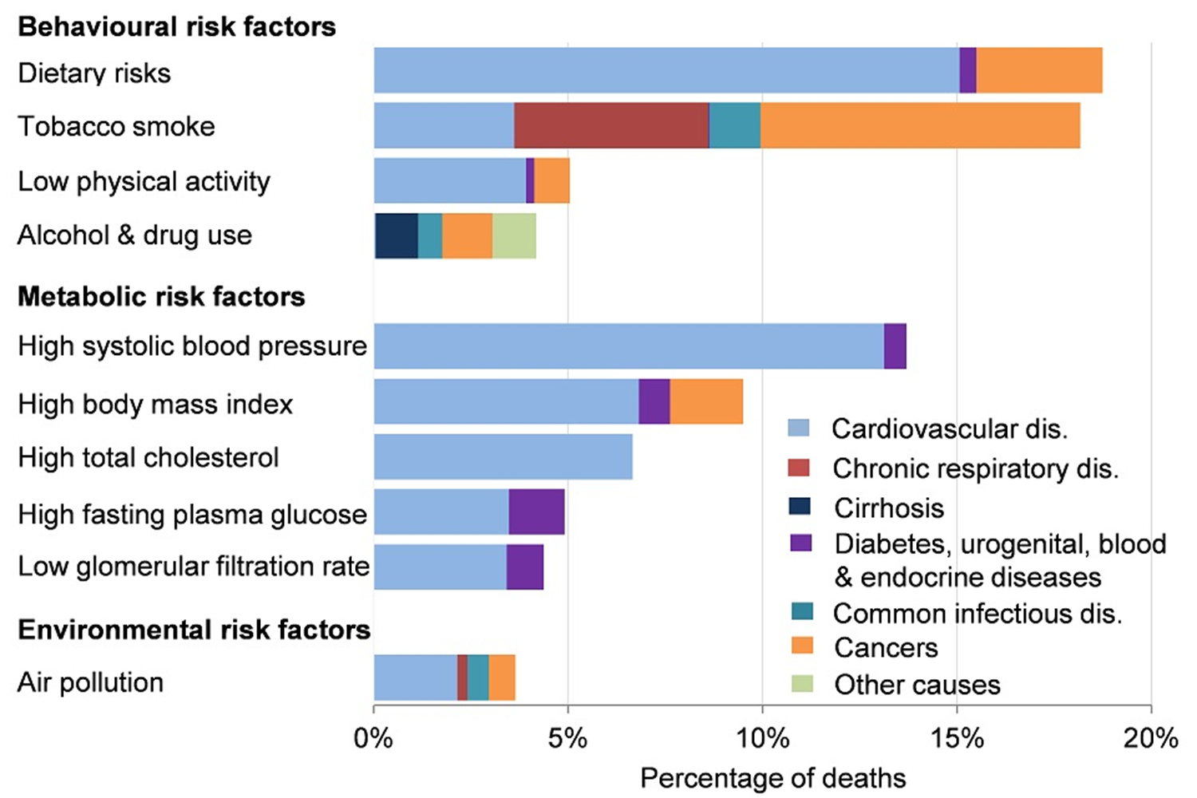
Risk factors for major chronic diseases in the UK

Slide 12
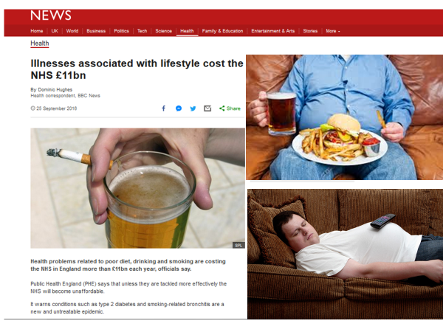

Slide 13
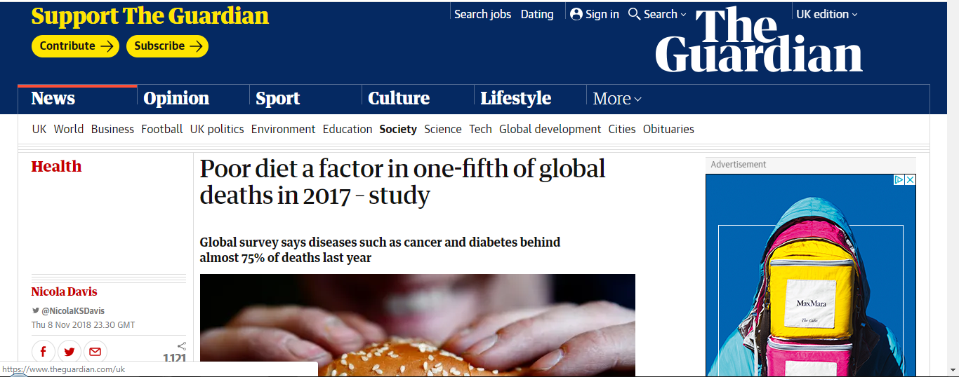
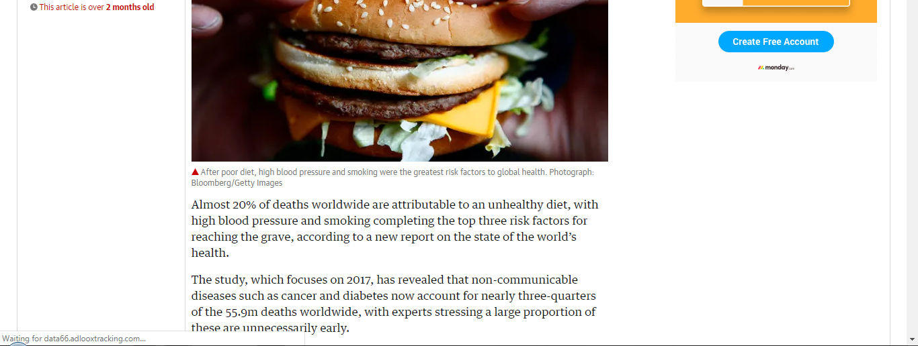

Slide 14
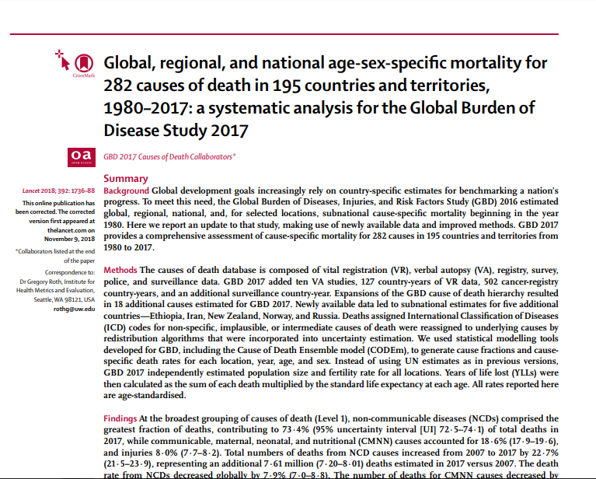

Slide 15
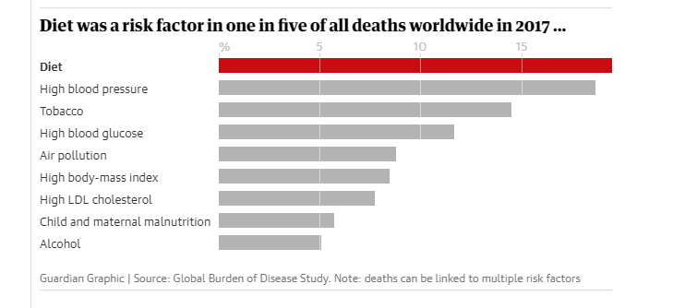

Slide 16
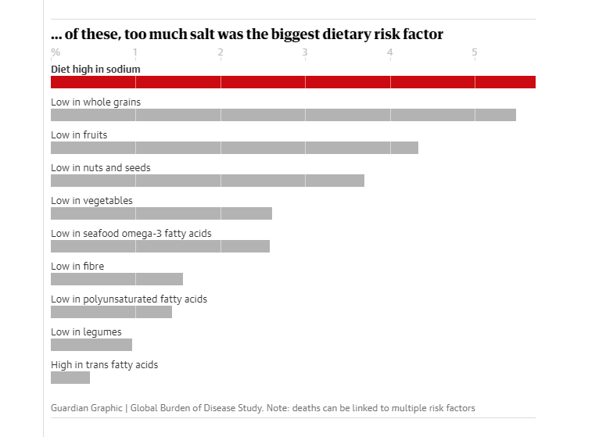

Slide 17

Costs to the NHS
NHS spent £4.2 billion on treating obesity in 2007, £6.2 bn in 2015 and now it is estimated to cost the NHS 11.4 bn/yr (2024)
£2.6 billion spent on smoking-related healthcare in 2015, NHS currently spending 1.9 bn/yr (2025).
Treating alcohol-related conditions cost the NHS approximately £2.7 billion in 2006/07, £3.5 bn in 2013-14 and 4.91 bn/yr in2025.

Slide 18
The findings from the INTERHEART study confirm:
Risk factors such as smoking, dyslipidaemia, hypertension, diabetes, abdominal obesity, adverse diet, physical inactivity and psychosocial factors account for 90% of the risk of myocardial infarction worldwide (Yusuf et al., 2004)
Detection and prevention of these risk factors in populations can have substantial benefits in reducing the burden caused by CVD (Yusuf et al., 2004)

Slide 19
Public health strategies for CVD prevention and care
  Improve prevention and risk management
  Improving and enhancing case finding in primary care
  Better identification of very high risk families/individuals
  Better early management and secondary prevention in the community
  Improve acute care
  Improve care for patients living with CVD
  Improve end of life care for patients with CVD
  Improve intelligence, monitoring and research and support commissioning

Slide 20
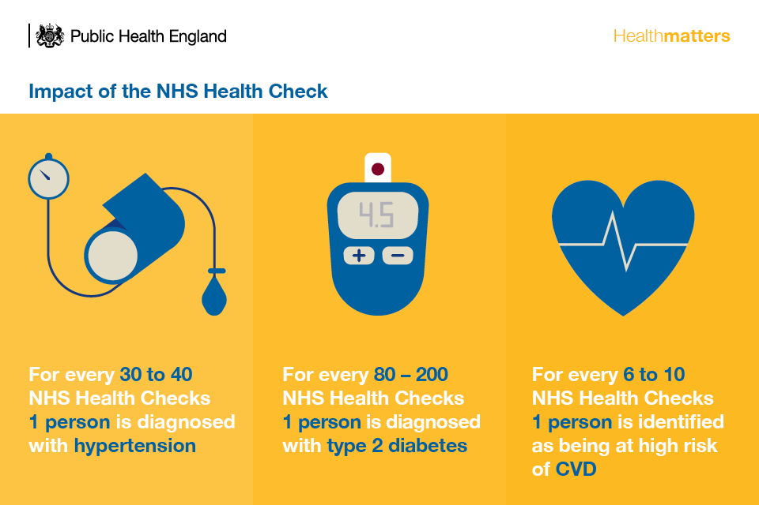

Slide 21

Primary Prevention
  Aims at reducing risk behaviours and identification of high risk individuals prior to development of CHD
  Improve maternal nutrition to increase birth weight
  Adopt prevention strategies from childhood; i.e. encourage children not to take up smoking, engage in physical activity
  Give help to smokers to stop or reduce smoking
  Promote healthy diets
  Encourage physical activity
  Reduce stress
  Improve personal control

Slide 22

Secondary Prevention
Identification of individuals at high risk:
  Provide screening for high risk people
  Encourage cessation of smoking, healthy diets and appropriate exercise

Slide 23
Tertiary Prevention
Treatment: appropriate/immediate i.e. access to medical care, defibrillators
Counselling and physical rehabilitation after a heart attack

Slide 24
NHS Health Checks
The NHS Health Check programme is a national risk assessment, awareness and management programme
Systematically targets the top seven causes of preventable deaths:
high blood pressure,
smoking,
high cholesterol,
obesity,
poor diet,
physical inactivity and alcohol consumption
(DH,2014)

Slide 25
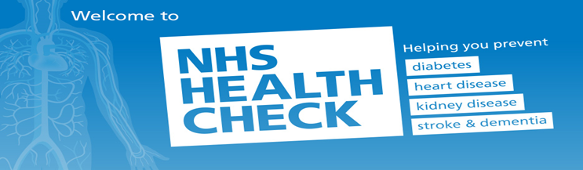
The main aim of the NHS Health Check is to prevent heart disease, stroke, diabetes and kidney disease, and raise awareness of dementia both across the population and within high risk and vulnerable groups (DH, 2014)
DH set targets and vascular checks guidance, to identify those people at risk of cardiovascular disease but who have not yet developed symptoms.
Once identified, appropriate advice and treatment should be offered
(DH 2008, 2009)

Slide 26
NHS Health Checks (NHSHC)
NHSHC was rolled out across England in 2009 to identify high risk individuals by screening two million people a year (DH, 2008)
NHSHC program intended as largest systematic prevention program in the world
Requires evidence
NHSHC was rolled out across England in 2009 to identify high risk individuals by screening two million people a year (DH, 2008)
NHSHC program intended as largest systematic prevention program in the world
Requires evidence

Slide 27
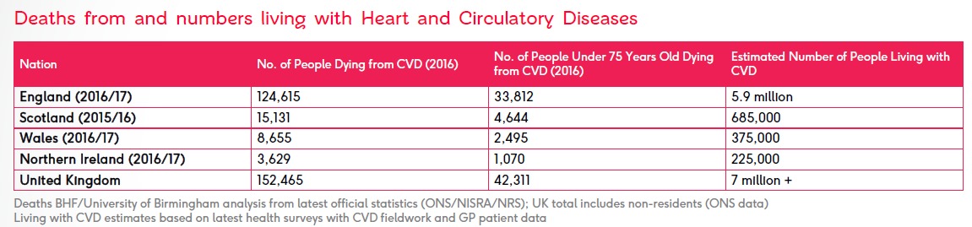
Why invest in a prevention program?
Death rate from cardiovascular diseases used (Coronary Heart Statistics 2000, DH 2013) used to be the number one cause of death in UK
Heart and circulatory diseases cause more than a quarter (26 per cent) of all deaths in the UK:
over 150,000 deaths each year
average of 420 people each day
one death every 3 mins.

Slide 28
Deaths from and numbers living with Heart & Circulatory Diseases (latest)
Nation | No. of People Dying from CVD (2024) | No. of People Under 75 Dying from CVD (2024) | Estimated Number of People Living with CVD (latest)
England | 137,572 | 37,723 | 7 million +
Scotland | 17,444 | 5,195 | 800,000 +
Wales | 9,260 | 2,660 | 400,000 +
Northern Ireland | 4,416 | 1,330 | 230,000 +
United Kingdom (total) | 169,205 | 47,257 | 8 million +

Slide 29
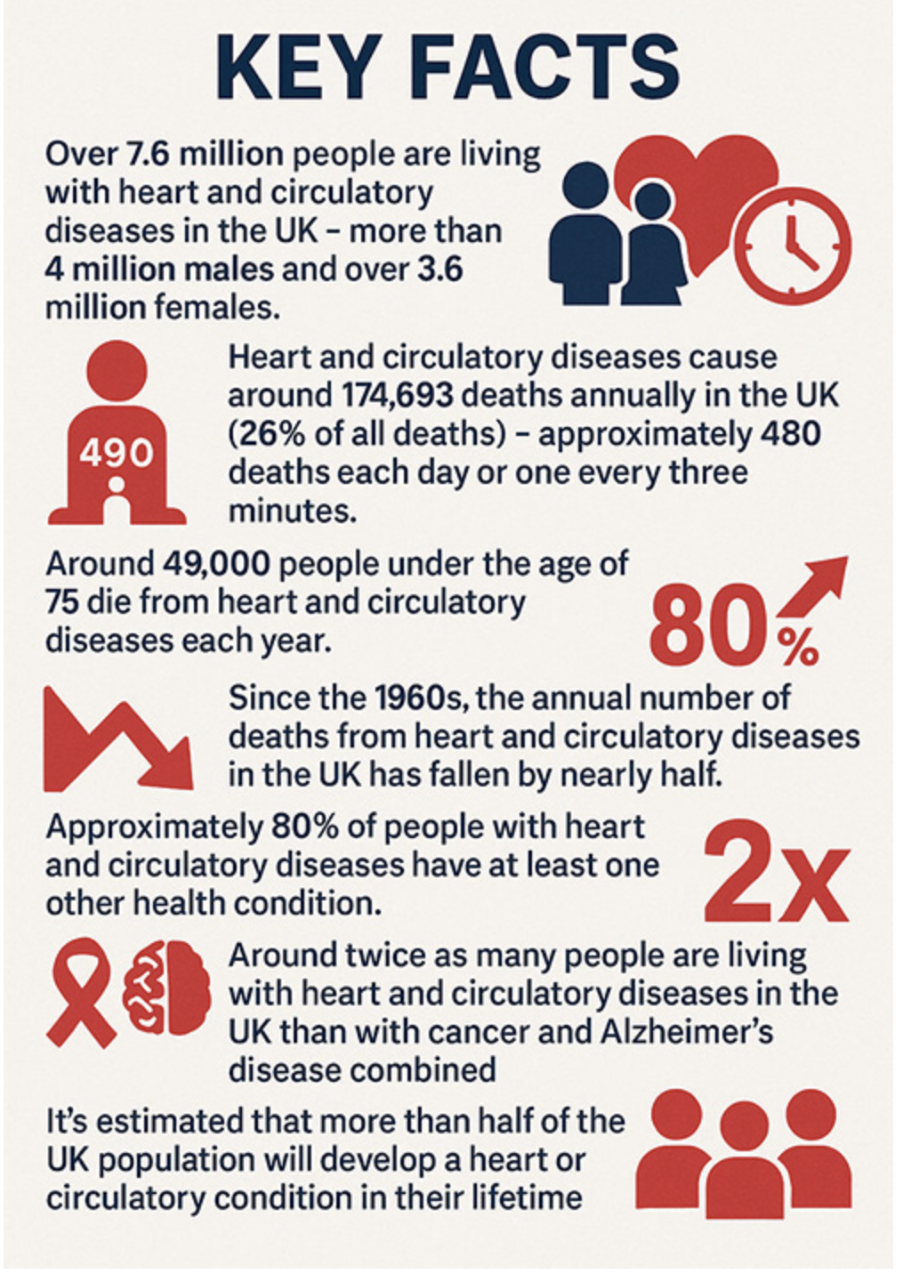
UK Heart and Circulatory Diseases Statistics (2025)
https://www.skillstg.co.uk/blog/uk-heart-and-circulatory-diseases-statistics/

Slide 30
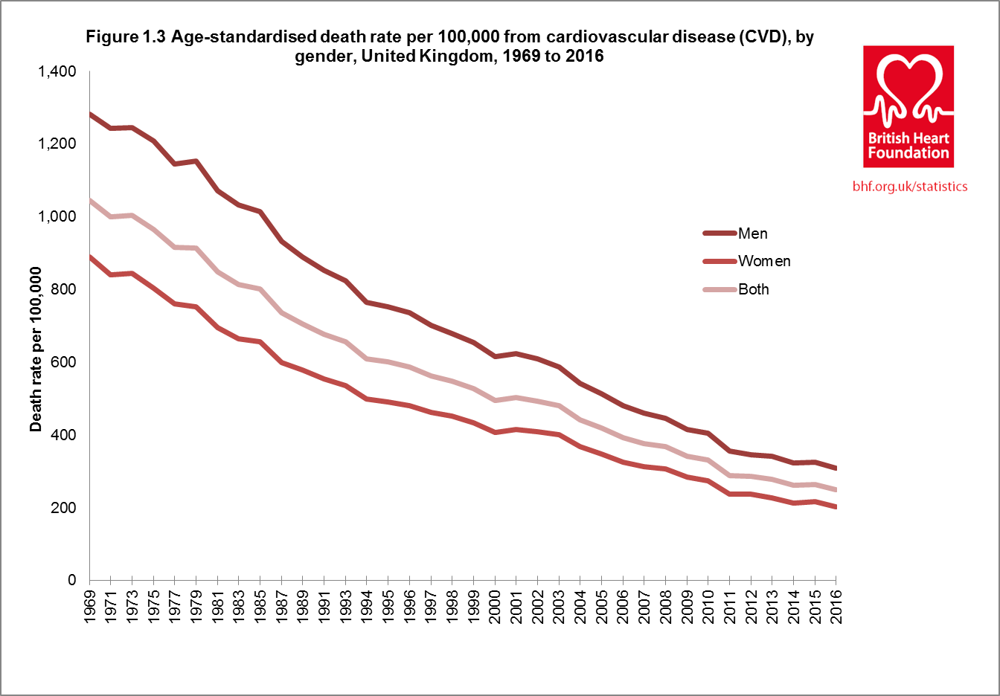

Slide 31
Recommendations for policy
NICE guidance outlines a clear evidence-based case that CVD is a major public health problem
Changes in risk factors associated with CVD can be achieved by intervening at the population and individual level
Government needs to address the risk factors at both levels
The final decision on whether these policies are adopted will be decided by government through normal political processes
(Prevention of cardiovascular disease NICE public health guidance NICE,2010)

Slide 32
NHS Health Checks- the Islington model
Islington- one of the most ethnically diverse communities in London with high levels of deprivation (DH, 2009)
Eighth most deprived borough in England and fourth in London
Two thirds of Islington residents live in the 20% most deprived areas in England (DH, 2010), resulting in a disproportionately higher rate of premature CVD (Davis et al., 2009)
Substantial health inequalities within the borough and CVD mortality is reported to be associated with increasing deprivation (DH, 2010).
CVD accounted for 35% of all deaths and 29% of deaths under the age of 75 in 2006-08 (DH, 2010)
Deaths from CVD are one of the biggest contributors to the inequalities gap in life expectancy in Islington

Slide 33
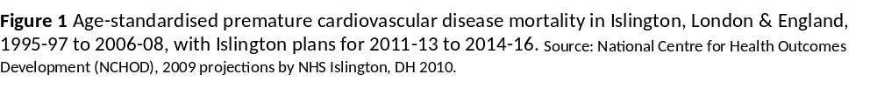
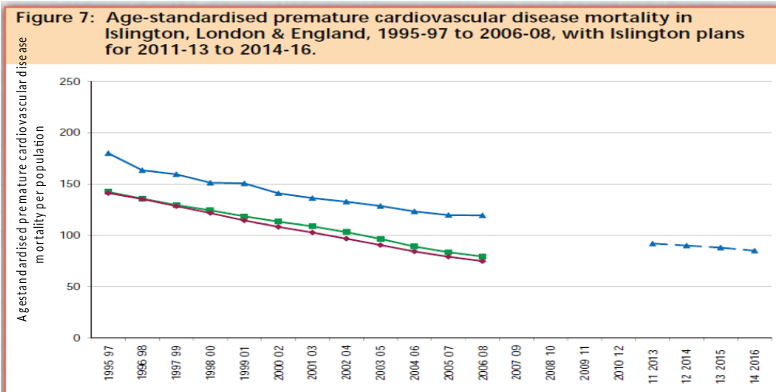
Fall in CVD mortality rates (number of deaths per 100,000 standardized for age) for Islington, London and England illustrating that whilst CVD mortality rates have been declining, the rate of decline is consistently slower for Islington compared to London and England hence furthering the gap in health inequalities

Slide 34
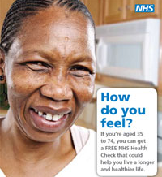
Islington NHS Health Checks (INHSHC)
The research team at London Metropolitan University were commissioned by Islington NHS to conduct an evaluation of the effectiveness and acceptability of the opportunistic health checks

Slide 35

Evaluation
Key function to improve performance of any aspect of health care delivery
Demonstrates whether a program is accomplishing its intended goals
Identifies weaknesses and strengths

Slide 36

The INHS Health Checks program targets all adults aged 35 (in Islington) to 74 for cardiovascular disease, type 2 diabetes and chronic kidney disease
Islington primary care trust (PCT ) delivered this program in 2009 through GP surgeries and pharmacies and extended the outreach in 2010 by using the community setting

Slide 37

Health Checks protocol for the community setting
NHS Islington commissioned Health Smart (service provider) to conduct the community based cardiovascular risk assessment service
Opportunistic cardiovascular health checks were conducted for Islington residents aged between 35-74 years with no existing cardiovascular diseases
Posters and leaflets were used to market the Health Checks
The service was available to both men and women resident in the borough of Islington
All participants indicated their agreement to a Health Check by signed consent

Slide 38



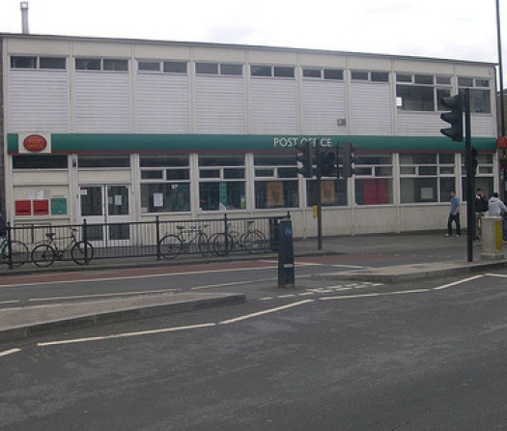
Venues for Islington NHSHC
During the period of July to December 2010 health checks were conducted on random days of the week at the following venues:
Islington Town Hall
Nags Head Shopping Centre
Waitrose, Holloway Road
Muslim Welfare House, Finsbury Park mosque
Archway Post Office
Arsenal Red Learning Centre
Andover Community Centre
Hanley Community Centre

Slide 39
NHSHC Methodology
Participants were recruited opportunistically by frontline staff and invited to undertake a health check
Participants were weighed and their height measured
Information about family and medical history, including current medications and level of physical activity, were obtained
All major CVD risk factors including total cholesterol and high-density lipoprotein cholesterol (HDL-C) plasma levels, systolic blood pressure and diastolic blood pressure, random blood glucose level (BGL), smoking habit, and body mass index (BMI; weight (kg)/[height (m)]2) were assessed
Total and HDL cholesterol levels and BGL were measured from finger prick blood samples using a portable desktop dry-chemistry analyzer

Slide 40

Data obtained by INHSHC
Participants’ 10-year risk of developing cardiovascular events, using cardiovascular disease risk algorithm (QRISK2) was calculated
Individuals whose 10-year absolute risk exceeded 20%
Detection of one or more abnormal test results (i.e., SBP greater than or equal to 140 mmHg; DBP greater than or equal to 90 mmHg
TC greater than or equal to 5.5 mmol/l; HDL-C below 1.0 mmol/l
Or random BGL greater than or equal to 8 mmol/l), were asked to see their general practitioner for further assessment or management.

Slide 41

Information given to participants
Referrals to smoking services, weight management services and exercise services were recommended where appropriate
a printed copy of their health check results and educational material published by the Food Standard Agency and Department of Health
verbal counseling about smoking, diet and exercise was also provided

Slide 42


Community Setting Evaluation
Two questionnaires were devised to evaluate the pilot program in Islington
Post-check questionnaire for face-to-face interviews after the health checks were completed to evaluate the delivery
Follow-up telephone questionnaire to evaluate the outcome of the health checks and assess change in risk factors

Slide 43
Post health-check questionnaires
Prior to the interview each participant was informed about the objective of the evaluation and advised that the interview would be confidential and would last no longer than 10 minutes (median time was 8 minutes)
Subjects completed the NHS consent form to the service provider indicating their willingness or otherwise to take part in the evaluation study
Consenting participants were approached directly by the researcher and invited to be interviewed at the intervention site after completion of their health checks
Interviewing participants immediately after they had used the service would enable the researcher to capture initial thoughts about the health check
This method of interview facilitated recall of the details of their experience and was thought to prevent the loss of data that may otherwise occur

Slide 44
Cardiovascular risk (n=1084)
Risk Factors and Cardiovascular risk Population, n (%)
Proportion with high CVD risk ≥ 20% 69 (6.4%)
Proportion with raised CVD risk 10-19% 198 (18.3%)
Proportion with normal CVD risk < 10% 817 (75.4%)

Slide 45
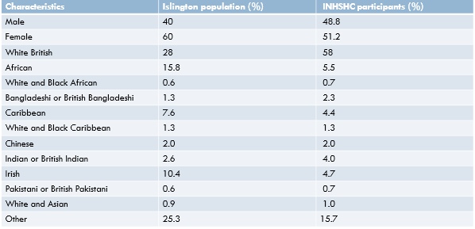
Population characteristics (n=1084)

Slide 46
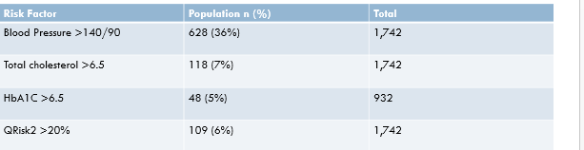
Percentage of population identified with risk factors for cardiovascular events

Slide 47
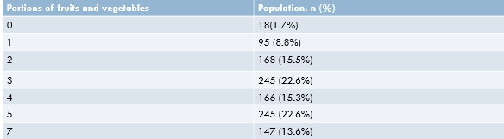
Portions of fruits & vegetables daily
(n=1084)
63.8% of the population consume less than five portions per day. This is a reflection of poor diet in deprived communities and is broadly in line with the estimates for Islington population (61%)

Slide 48
Post-check questionnaire findings
100 participants were involved in the pilot evaluation of the Islington NHSHC
Representative in terms of age and level of employment
A disproportionately higher number of females (69%) took part in the survey reflecting higher number of female subjects who had health checks
Over-representation of English participants (54%)
Only 7% were from an Asian or African background, although higher participation rates were observed in the health checks suggesting the latter were not motivated to stay and be interviewed post-check, but still attended the NHSHC
Paid employment (52%) was the most frequent work status ; this was consistent with the Islington population

Slide 49
Key findings
The community Health Checks were accessed by a representative population of the Islington borough, with good engagement of the black and minority ethnic groups
The NHS Health Checks program was able to identify participants who were not registered with a GP and those who had elevated risk factors for cardiovascular events
Participants preferred the ease and convenience of the opportunistic venue (n=65) rather than the GP surgery (n=13) or the pharmacy (n =4)
Almost all (n=99) stated they would engage in the programme again in 5 years time

Slide 50
Follow Up Outcome
The concept of ‘overall risk’ was difficult for some participants to grasp (n=34) , reporting confusion in the post-check evaluation interview
The 12-month follow-up evaluation showed that 79% of those referred to their GP had visited the surgery and 62% were given a formal diagnosis
Some encouraging behaviour modification was reported: weight loss achieved by 47% of the respondents and 72% increased physical activity
Only 18% managed to consume 5 portions of fruit and vegetables per day

Slide 51
Limitations of the evaluation
Limitations of Self‑Reported Data
Self-reported information is prone to recall bias and social desirability bias, which can reduce accuracy when assessing lifestyle behaviours and health risks.
Questionnaires often exclude objective clinical measurements, limiting the ability to fully assess cardiovascular risk.
Evidence of Underreporting
Previous research has shown substantial underreporting of key CVD risk factors, particularly smoking, when self-reports were compared with objective measures (O’Loughlin et al., 1995).
Underreporting can reduce the sensitivity of the evaluation, leading to misclassification of individuals' true risk status.
Impact on Validity
Without objective clinical data, misclassification of risk factors is more likely, which can undermine the validity and reliability of evaluation findings.
This limits researchers’ ability to draw accurate conclusions about the programme’s effectiveness.

Slide 52
Limitations of the evaluation
Use of validated measures on self-reported behaviour can help reduce the bias which is inherent in these types of evaluations
As no data was collected from those who refused to undergo health checks, not able to assess demographic details and deduce reasons which prevent individuals from taking part in health checks
This type of information can be useful in addressing barriers which prevent any such intervention reaching certain groups of the population

Slide 53

Conclusion
Opportunistic cardiovascular risk assessments within community settings are feasible and highly acceptable
The service is able to detect high risk individuals, and effective in widening access to healthcare in an ethnically diverse community
The NHS Health Checks programme is effective in raising awareness and engaging the population to modify their lifestyle behaviour

Slide 54
Recommendations
Widen
Widen the scope of locations of the opportunistic community health checks throughout the Islington borough
Improve
Improve level of awareness of the health checks by advertising locally e.g., flyers through letterboxes, posters and adverts in local newspapers
Utilize
Utilize the services offered by lifestyle and behaviour modification professionals in a better capacity
Continue
Continue with follow-ups of the health checks to monitor success and identify barriers

Slide 55
References & further reading
British Heart Foundation, 2007 & 2013 Coronary Heart Disease Statistics.
Department of Health. NHS Putting Prevention First, NHS Health Check: Vascular Risk Assessment and Management. Best Practice Guidance. 2009.
Department of Health NHS Health Check; Vascular risk assessment and management best practice guidance. London: Department of Health 2009.
Department of Health Tackling health inequalities: 2007 status report on the programme for action. London: Department of Health. 2008.
Department of Health. Putting prevention first Vascular Checks: risk assessment and management. London: Department of Health 2008.
Department of Health. NHS Islington Public Health Department. Health in Islington: The facts. 2009
Department of Health. NHS Islington. Health in Islington Factsheet. 2010. www.islington.nhs.uk
Hippesley-Cox j, Coupland C, Vinogradova V, 2008 BMJ 336, 1475-82
Murray CJ and Lopez AD, Alternative projections of mortality and disability by cause 1990-2020: Global, Burden of Disease Study. Lancet 1997(24);349:1498-504.
Murray DM, Luepker RV, Pirie PL, et al. Systematic risk factor screening and education: a community-wide approach to prevention of coronary heart disease. Prev Med. 1986;15:661-672.
Richardson G, van Woerdeb HC, Mereid B et al, 2008 BMC Cardiovascular Disorders 8:18

